Slide 1
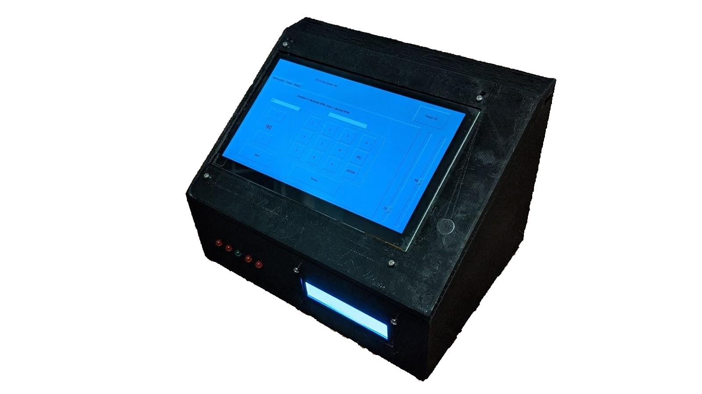
All-In-One Music Aid: LUQ MetroTuner Pro
Luigi Quattrociocchi
&
Umberto Quattrociocchi
Notes:
Umberto

Slide 2
Summary of our presentation
What the MetroTuner Pro does and its purpose
Real-world applications of the MetroTuner Pro
Video of the MetroTuner Pro working in a commercial format
How we would market and sell the MetroTuner Pro
The competing products on the market, and the competitive advantage the MetroTuner Pro has
Future improvements for the MetroTuner Pro
Execution of the future improvements outlined
Notes:
Umberto

Slide 3
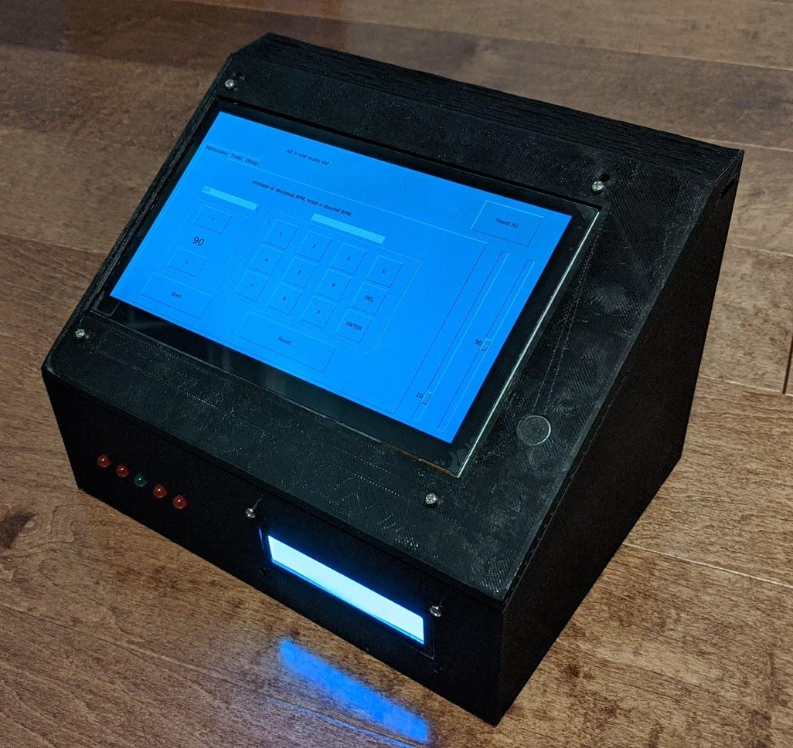
Our project and its purpose
Our project is the LUQ MetroTuner Pro: an all-purpose solution in a self-contained system designed to aid you in your musical endeavors. Our product’s main features includes those listed below:
Drone playback with variable note, octave, and wave type
Tuner with visualization of cents sharp/flat
Metronome with variable BPM and choice of beat pattern
Master tuning frequency adjustment
System volume adjustability
Notes:
Luigi

Slide 4
Real-world applications of our product
Our product is a practical solution to a couple of key issues that affect all types of musicians, from hobbyist to professional. Issues that our product solves that musicians face include but are not limited to:
Playing out of time, or with inaccurate rhythm
Instrument out of tune (inaccurate intonation)
Difficulty matching a certain note and hearing the intervals of a melody
Each of the major functions of our product are presented in its own tab for an intuitive user experience:
Notes:
Umberto

Slide 5
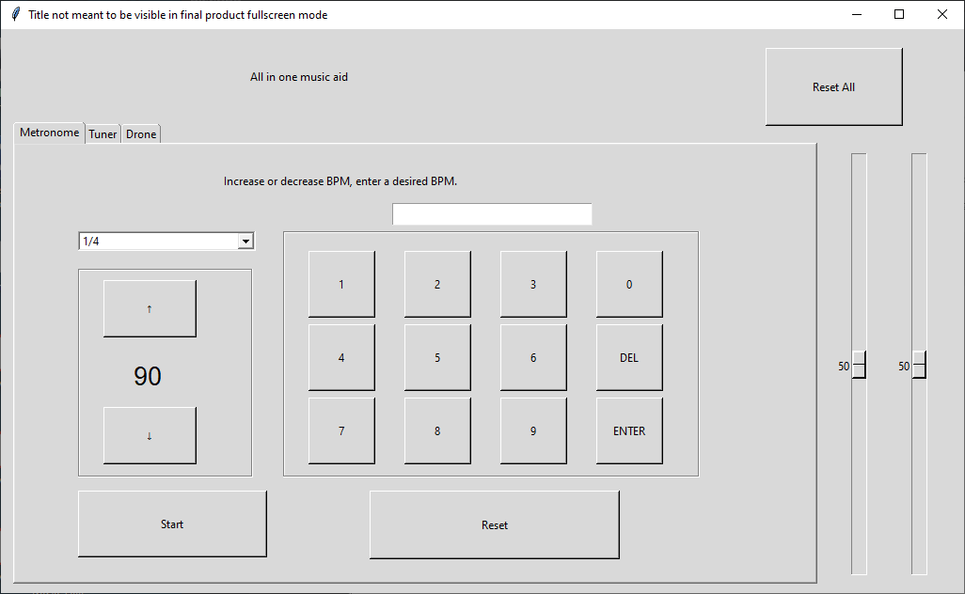

Slide 6
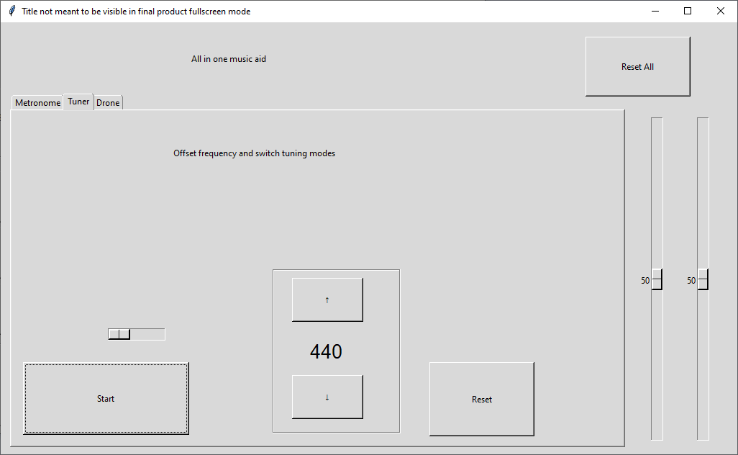

Slide 7
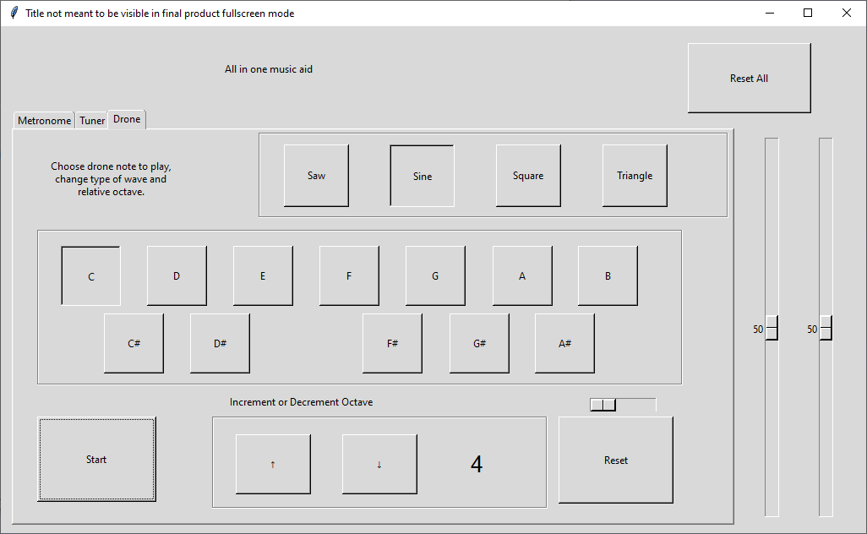

Slide 8
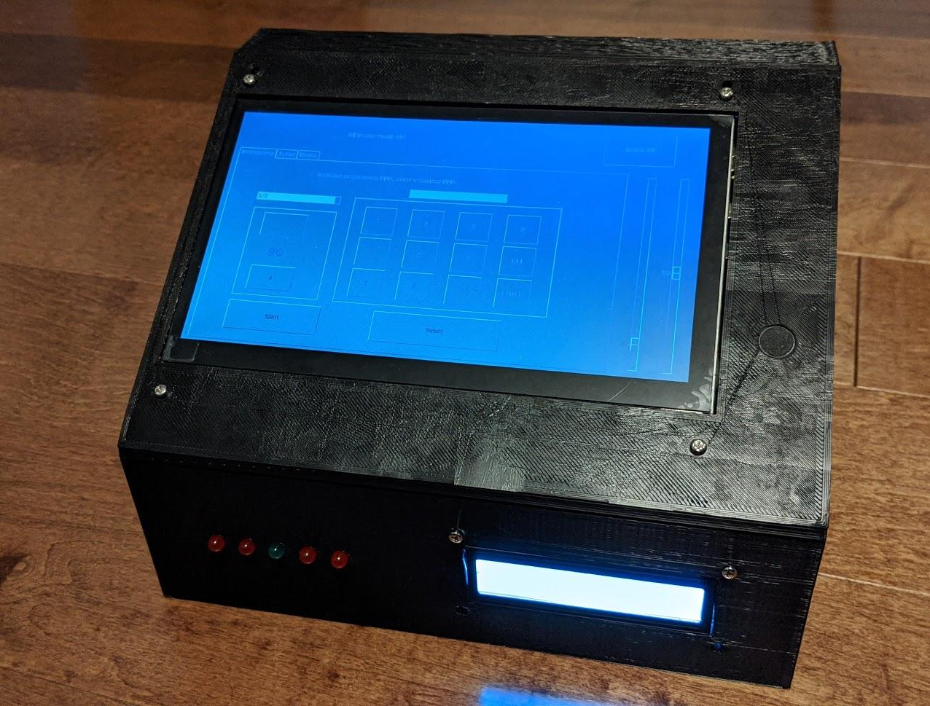
How we would market/sell it
Our target audience include musically inclined individuals, enthusiasts, music teachers, conductors, etc. Knowing this, we can create adverts that focus on this target audience.
One major selling point of our product is the convenience factor it presents itself with; as a practice aid for musicians, it offers virtually all of the immediate functionality one might require.
Since our product includes many features, we would likely be able to market it as a “Pro” device, allowing us to charge a higher cost to make up for the cost of development and parts.
In a practice setting, our product proves to be useful. As a portable device, however, it leaves something to be desired...
Notes:
Umberto

Slide 9
Competing products and the competitive advantages of our product
A wide variety of tuners, metronomes, and drones exist and are sold individually at moderately low prices, as both physical objects and apps. These products offer a portable and easy-to-use experience, often with a single purpose.
As a tool for musicians in a practice setting, our product offers features that nearly no other device offers in one single unit. We believe that consumers would be drawn to our product for its convenience as well as its ease of use. For this reason, the MetroTuner Pro is single-handedly able to take the place of a variety of different products a musician might need.
Let’s see some examples of competing products...
Notes:
Luigi demo: visor tuner, physical product

Slide 10
Future improvements
A few limitations of our current prototype of the MetroTuner Pro include:
Limited capabilities of the analog microphone
Selection of a higher-quality microphone may improve the tuner’s functionality
The portability of our product
The current size and weight of our design can be improved to increase portability
Power consumption and efficiency of the circuitry
A modified design with a smaller screen and integrated circuitry would improve this
Ease of use
Quality-of-life improvements, such as a more accessible interface and ergonomics would make the product easier to use
Bugs/anomalies in the code
Functionality and response of product may be improved through intensive testing and code tweaks
Difficulties and costs associated with manufacturing
A design made of a material easier to machine or mould would improve the potential for manufacturing in the future
With a more optimized production process and a more economical and efficient part selection, we would be able to create a product with potential to make profit.
Notes:
Umberto

Slide 11
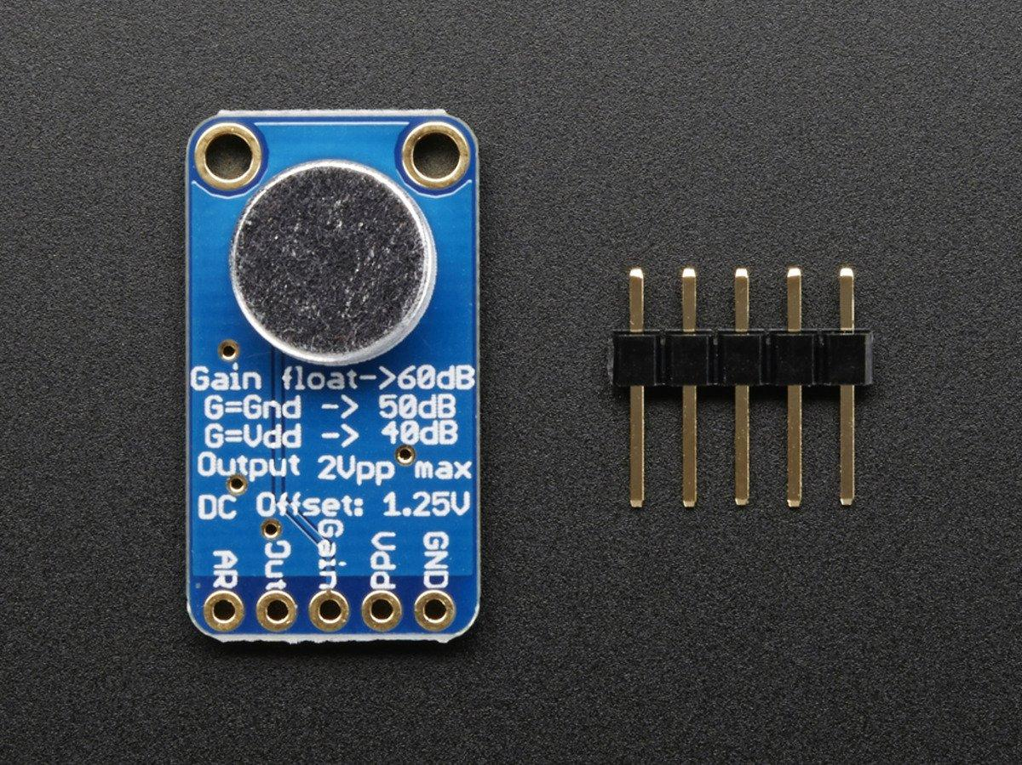
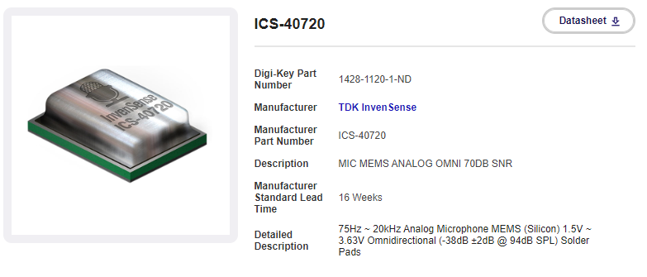
Execution of future improvements: Microphone
Currently, we are using the MAX8914 as the microphone for our tuner. In choosing a more powerful microphone, factors to consider include the both cost and functionality of the microphone. A viable option for the microphone is the ICS-40720. With this, a more affordable, integrated microphone could be implemented (buying at quantity would result in a ~$3 mic).
Notes:
Umberto

Slide 12
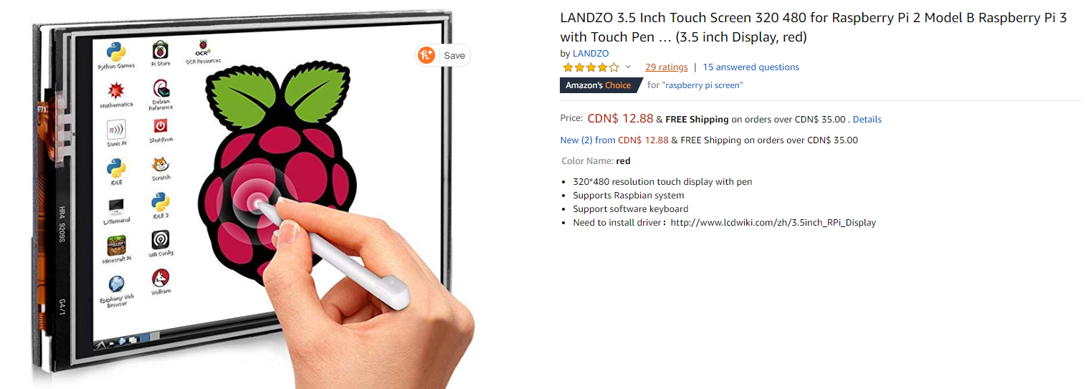
Execution of future improvements: Size and weight
Using a smaller touchscreen in combination with an integrated circuit for our product would result in a smaller, lighter, and more portable product. A viable option for the screen is a 3.5-inch touchscreen (currently 7-inch):
Notes:
Luigi

Slide 13
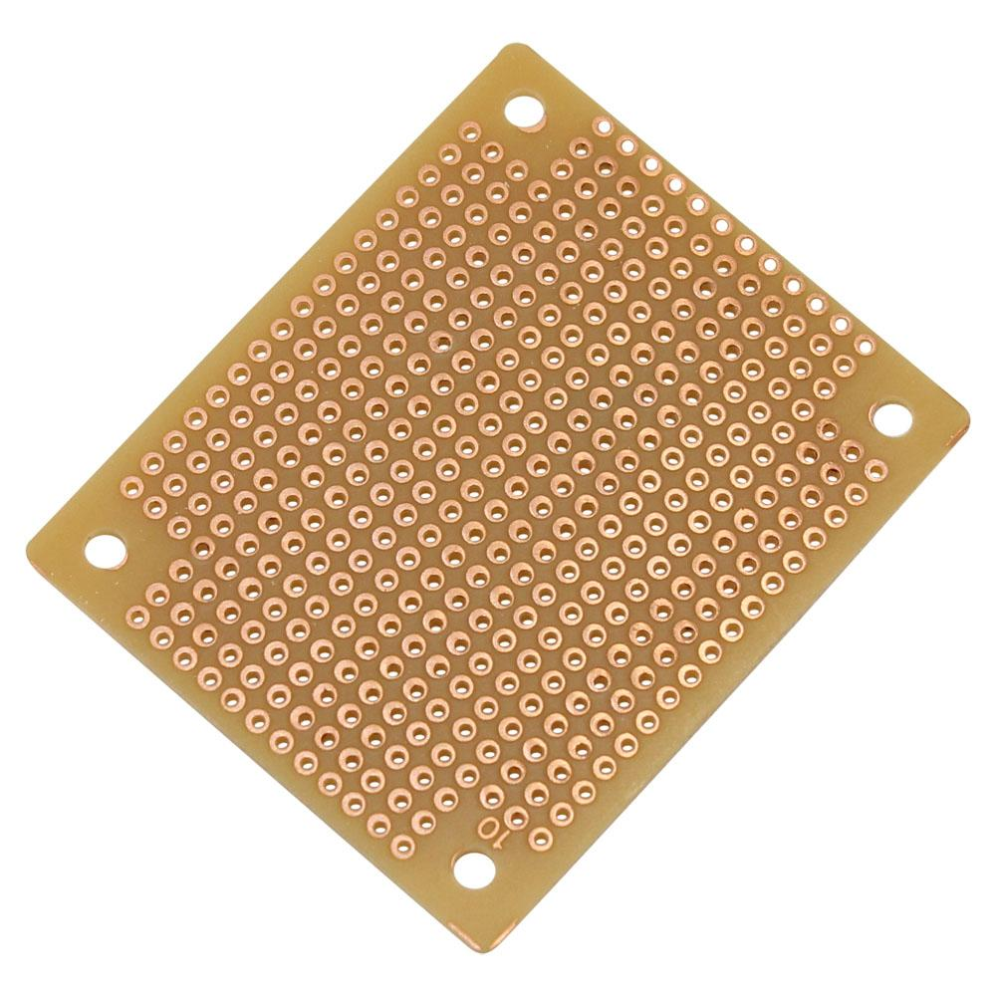
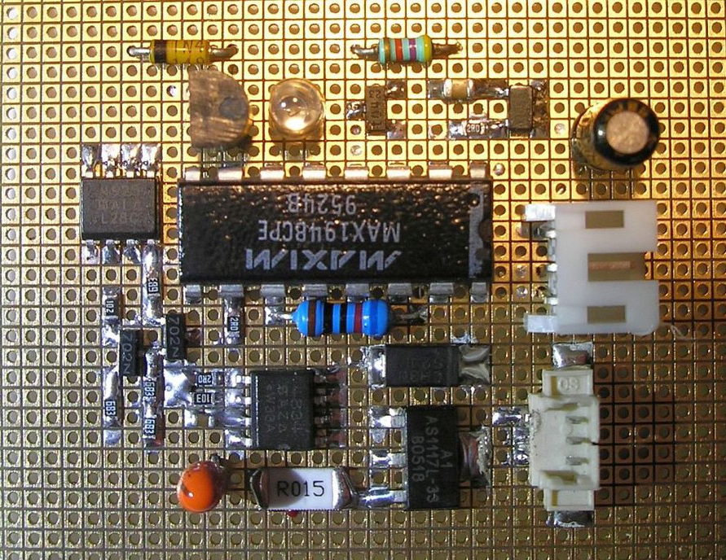
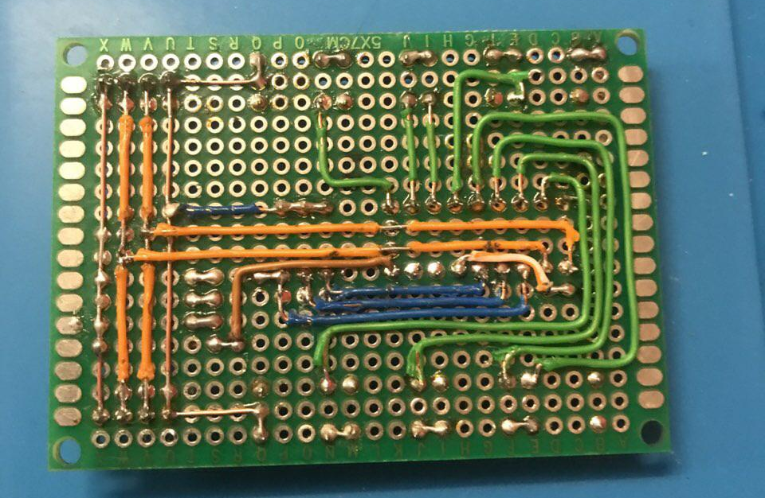
Execution of future improvements: Size and weight
Using a perfboard would be a good way to reduce size without giving up rapid prototyping, though soldering is required.
The wiring and tidiness of our current prototype is limited by our supply of wires and the space inside the enclosure. These issues would not exist if we were to develop an integrated circuit to replace the Pi, Arduino, and circuitry currently in place.
Notes:
Luigi and pictures

Slide 14
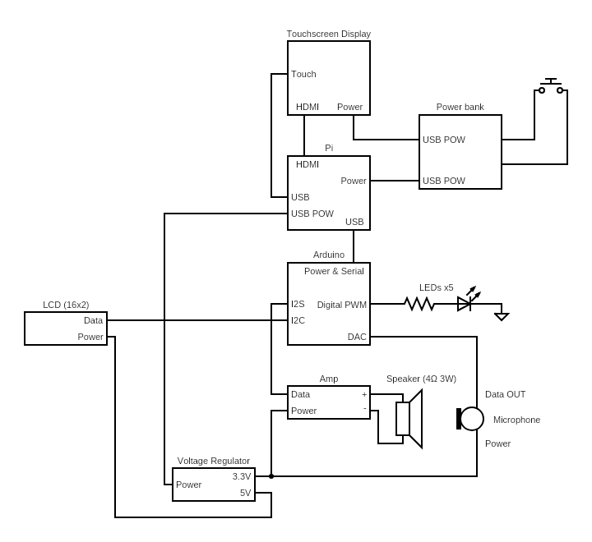
Caution: The next slide contains graphic images that some viewers may find disturbing.
Viewers’ discretion is advised.

Slide 15
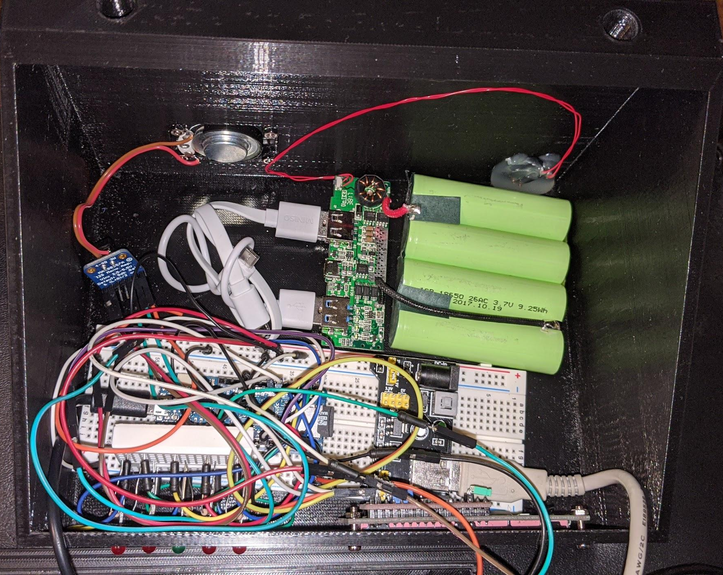

Slide 16
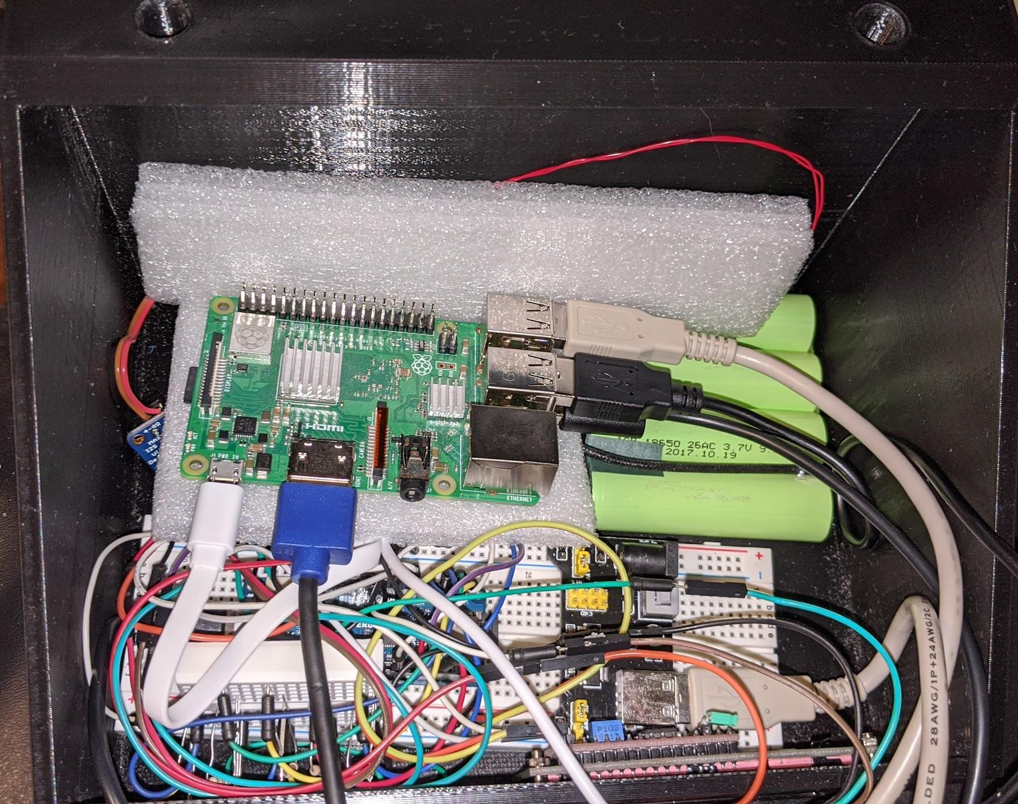

Slide 17
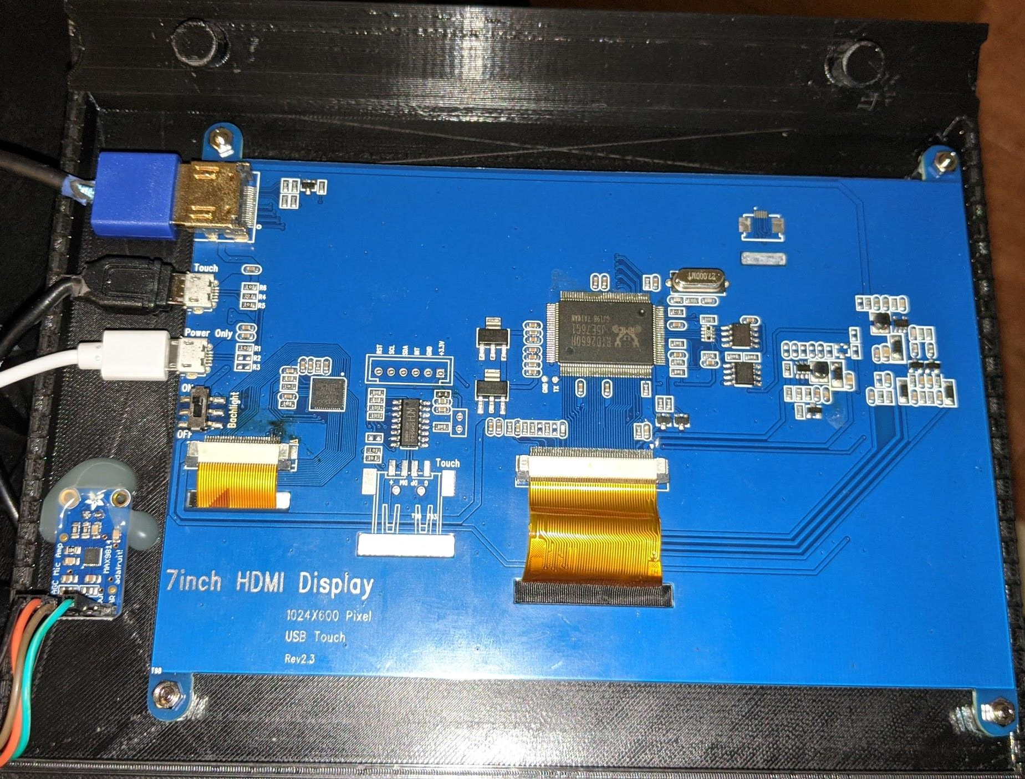

Slide 18

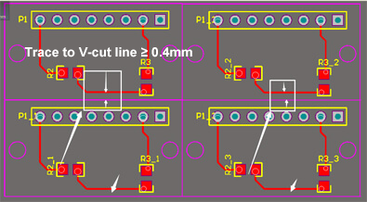
Execution of future improvements: Power consumption and efficiency of circuitry
One way to majorly increase the efficiency of our product would be to switch out the Raspberry Pi and Arduino for an integrated circuit with the firmware necessary to control our software and hardware. With a redesign, we could print PCBs using JLPCB:
“JiaLiChuang (HongKong) Co., Limited, is the largest PCB prototype enterprise in China and a high-tech manufacturer specializing in quick PCB prototype and small-batch PCB production. With Over 10 years of PCB manufacturing experience, we’re able to provide cost effective solutions that deliver the highest reliability PCB products to customers faster.”
Notes:
Umberto

Slide 19
Execution of future improvements: Ease of use
The interface of our product, especially if the size of our touchscreen is reduced, would benefit from a redesign, including larger buttons and easier-to-read text.
With a redesign of the enclosure to fit the smaller screen, the edges of the product could be rounded out, and given a shape that is easier to handle and transport.
Currently, simultaneous functionality of the separate features is not supported. With a significant code modification, this may be implemented.
Notes:
Luigi

Slide 20
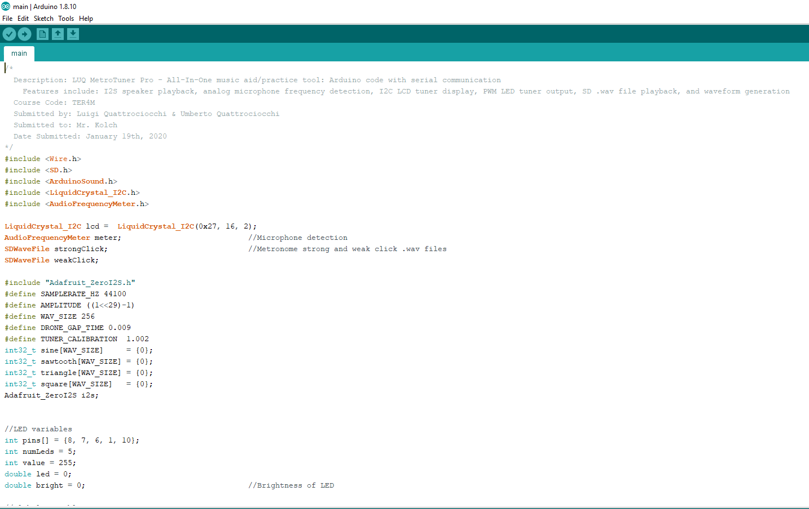
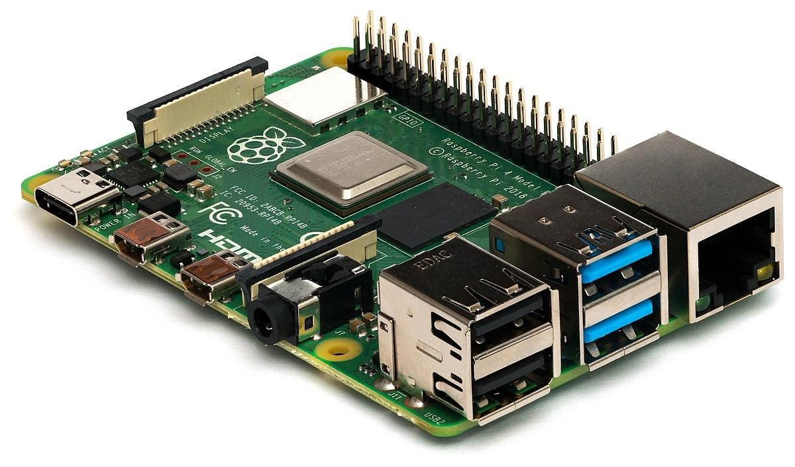
Execution of future improvements: Bug fixes and testing
If we were to incorporate an integrated circuit into our product, our existing python and arduino code would have to be ported over to C#, running on our proprietary chip. Future testing is required to fix unnoticed errors that may appear. Ideally the final size of our circuit board would be about the size of a Raspberry Pi.
Notes:
Umberto

Slide 21
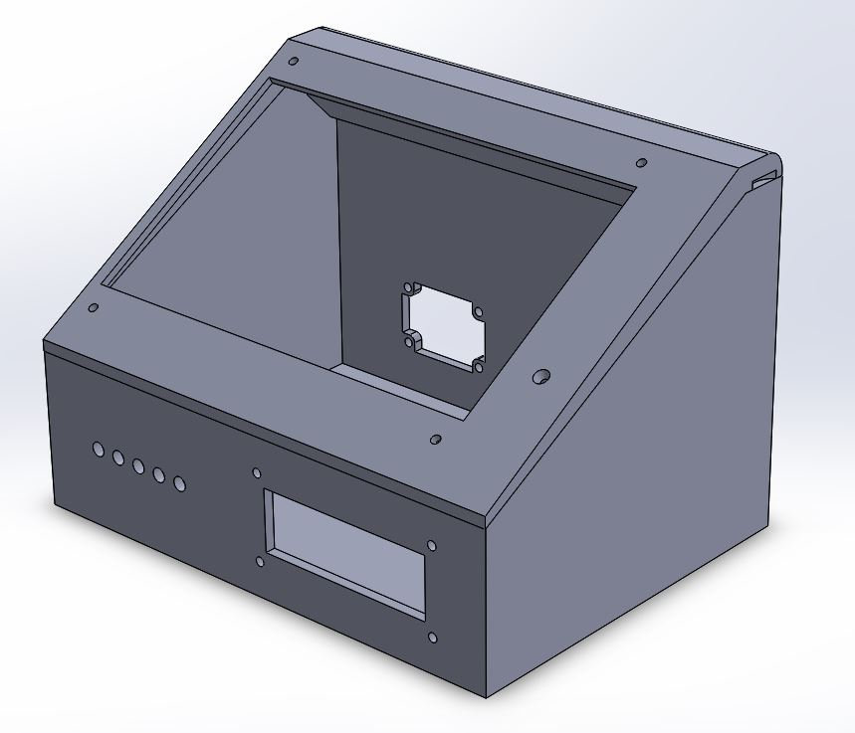
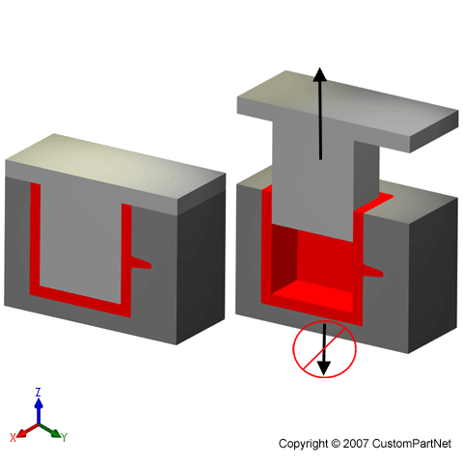
Execution of future improvements: Manufacturing - materials, etc...
Instead of 3D printing for prototyping purposes, a final version of the enclosure could be made out of a molded or machined material (likely in plastic or aluminum).
Notes:
Luigi

Slide 22
Thank you for your attention! LUQ hopes you are interested in our MetroTuner Pro!
Notes:
Luigi

